Slide 1
Unit 1
Overview and history of Engineering. Engineering marvels of the ancient world. Connections between Science and Engineering, connection between Maths and Engineering. Roles of different fields of Engineering - Discussion & Short presentation
Introduction to Electrical Engineering, current and voltage sources, Resistance, Inductance and Capacitance; Ohm’s law, Kirchhoff’s law, Energy and Power, Super position Theorem, Network Analysis – Mesh and Node methods
Faraday’s Laws of Electro-magnetic Induction, Magnetic Circuits, Self and Mutual Inductance
Single Phase, 3 Phase and Network Grids.

Slide 2
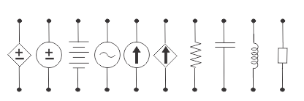
Lecture 1 Introduction to Electrical Engineering

Slide 3
Contents
Circuit Elements
Active & Passive Elements
Sources
Current and Voltage Sources
Ideal & Practical Sources
Independent & Dependent Sources
Reference Symbols
Network & Circuits
Active and Passive Circuits
Reference Directions
Node, Path, Loop and Branch
Numerical Examples

Slide 4
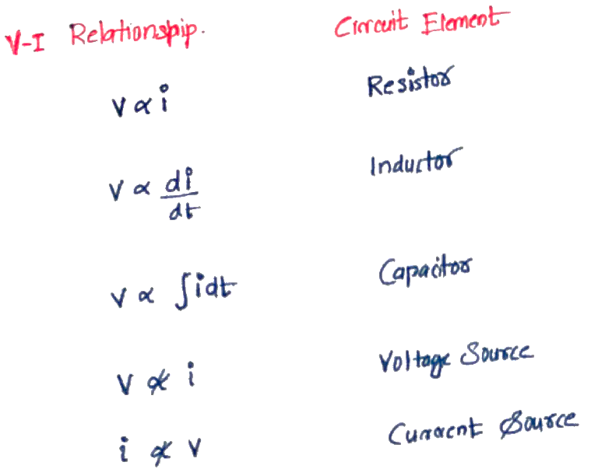
Circuit Elements
Circuit elements are defined based on the mathematical relationship of current through the element and voltage across the element
Lecture 2

Slide 5
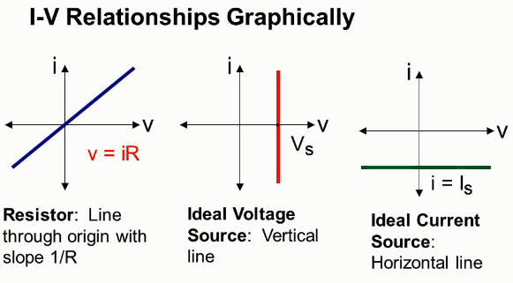
Circuit Elements
If the voltage across the element is proportional to the
current through it, the circuit element is
Resistor
derivative of the current
Inductor
Integral of the current
Capacitor
independent of the current
Ideal Voltage Source
dependent on the current or voltage elsewhere
Dependent Voltage Source
If the current through the element is
independent of the volatge
Ideal Voltage Source
dependent on the current or voltage elsewhere
Dependent Current Source
Lecture 2

Slide 6
Active & Passive Circuit Elements
Active element is an element capable of supplying an average power(>0) for infinite time interval.
Eg. Ideal Sources
Passive element is an element incapable of supplying an average power(>0) for infinite time interval.
Eg. Resistor, Capacitor, Inductor
R is a passive circuit element that dissipates energy
C and L are passive circuit elements, having the ability to store and deliver finite amount of energy.

Slide 7
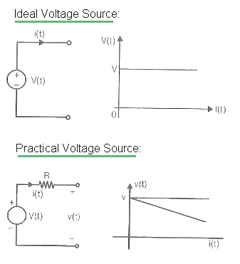
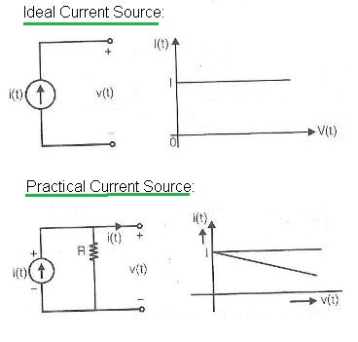
Ideal & Practical Sources
An ideal source is an active element that supplies specific voltage or current independent of other circuit elements.

Slide 8
Ideal & Practical Sources
Ideal voltage source
Voltage remains constant
Zero internal resistance in series
Practical voltage source
Modelled as Ideal voltage source in series with internal resistance
Ideal Current source
Current remains constant
Infinite internal resistance in parallel
Practical Current source
Modelled as Ideal current source in parallel with resistance.

Slide 9
Ideal & Practical Sources
An ideal current source supplies a current of 300mA to a load of 1kΩ. When the load is changed to 100Ω, the load current will be
(a) 3A
(b) 300mA
(c) 30mA
(d) 100mA[3]
Solution
(b) 300mA
Current supplied by the ideal current source remains the same and is independent of the load variations.

Slide 10
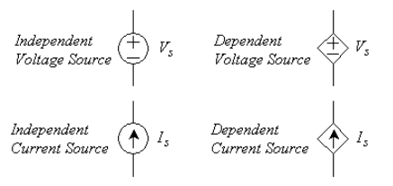
Independent & Dependent Sources
Independent Source
Ideal independent source maintains same voltage or current unaffected byother circuit elements present in the circuit.
Dependent Source
A dependent voltage or current source is one whose value is proportional to another voltage or current in the circuit.
Symbols : Independent & Dependent Sources
Dependent source -Classification
 | Voltage Source | Current Source
Voltage Controlled | Voltage Controlled Voltage Source VCVS | Voltage Controlled Current Source VCCS
Current Controlled | Current Controlled Voltage Source CCVS | Current Controlled Current Source CCCS

Slide 11
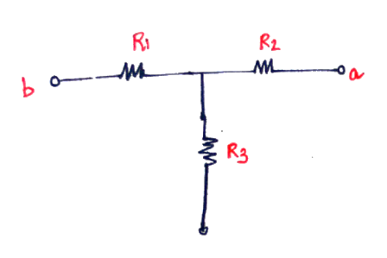
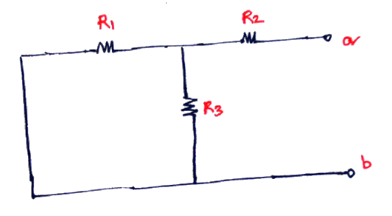
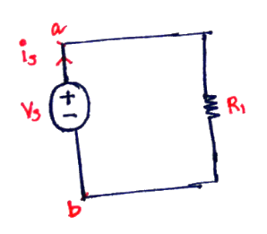
Network & Circuits
Network & Circuits
Connection between two or more “circuit elements”
A network with closed path is a circuit
Every circuit is a network, every network isn’t a circuit
Active & Passive Networks
Network with active elements(at least one voltage source or current source) is an active network
Passive network does not contain an active source.
(passive)
network
circuit
active network

Slide 12
Reference Directions
Voltage
To define voltage across an element, a value and polarity must be given. (the terminals must be labelled with “+” and “-” signs)
Current Flow
To define current flow, a value and a direction must be given
“arrow” is used for labelling current directions
Positive Current flow direction, opposite to electron flow direction
Current flows from higher potential to lower potential in passive elements. Current flows from lower potential to higher potential in active elements(Sources).
Power Flow
Positive current flows out of positive terminal, the element supplies power.
Positive current flows into the positive terminal, the element absorbs power.

Slide 13
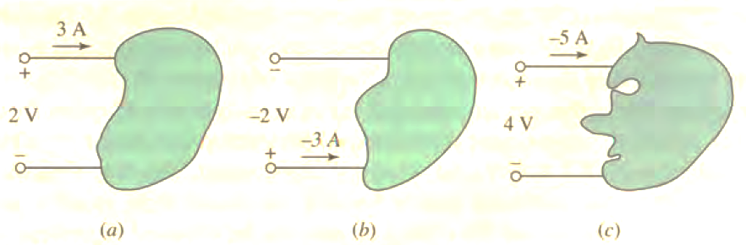
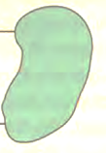
Reference Directions: Numerical Example
Find the power in the circuit (a),(b) and (c)?
Solution
(a) Pa = (+2)*(+3) = +6W
(b) Pb = (-2)*(-3) = +6W
(c) Pc = (+4)*(-5) = -20W

Slide 14
Network Terminologies
Node :
Point of connection between 2 or more “circuit elements”
Branch
A single path in a network
With 1 simple element and node at each end
Path :
While moving from one node to another, no nodes are encountered more than once.
Closed Path/Loop
A loop is a closed path in a network formed by no of connected branches
Starting node = Ending node
Mesh
Mesh is a loop that contains no other loop within it.

Slide 15
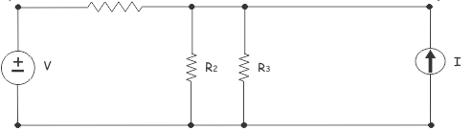
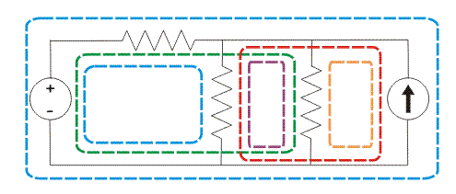
Network Terminologies: Numerical Example
Find the number of meshes, nodes and loops in the circuit below?
Solution
(a) No of Meshes =3
(b) No of loops = 6
(c) No of nodes = 3

Slide 16
References
[1] Edward Hughes. “Electrical and Electronic Technology”, 10th Edition, Pearson Education Asia, 2011.
[2] William H. Hayt Jr. ,Jack E Kemmerly, Steven M Durbin, “Engineering Circuit Analysis”, 6th Editions, Tata McGraw Hill Publishing Company
[3] Vincent Del Toro, ‘Electrical Engineering Fundamentals’, Second Edition, Prentice Hall of India Private Limited, 2003

Slide 17
Thank You

